Slide 1
Analyzing Environmental Issues
Tough Choices

Slide 2
Why do we have environmental issues in the first place?

Slide 3
What is an issue?
Issue- An issue is a problem or solution for which people have differing values or opinions. The issue usually involves two or more parties who do not agree.

Slide 4
Why do we have environmental issues?
If everyone had the same viewpoint, there would be no controversy
People have different views on the environment
Anthropocentric
Biocentric
Ecocentric

Slide 5
Today’s Mission:
For you to analyze an environmental issue.
While we have discussed some environmental issues, we’d like you to actually analyze one today.
What do you think the difference, if any, is between discussing and analyzing?
Discuss with the person next to you

Slide 6
When discussing something you are just describing the general idea of something.
When analyzing something you are examining the material in a methodical (structured) way.

Slide 7
Components of an Environmental Issue
Issue
Facts
Players
Position
Values
Opinions
Solutions

Slide 8
What is an issue?
Issue- An issue is a problem or solution for which people have differing values or opinions. The issue usually involves two or more parties who do not agree.

Slide 9
What is a Fact?
What makes something a fact rather than an opinion?
Discuss with your table partners and come up with your definition

Slide 10
What is a Fact?
It is a piece of information that is true and can be verified.
As one analyzes an environmental issue, it is helpful to verify the facts.

Slide 11
Who are the Players?
Players are the individuals and groups involved in an issue.

Slide 12
What are Positions?
Positions are the player’s stance on the issue.

Slide 13
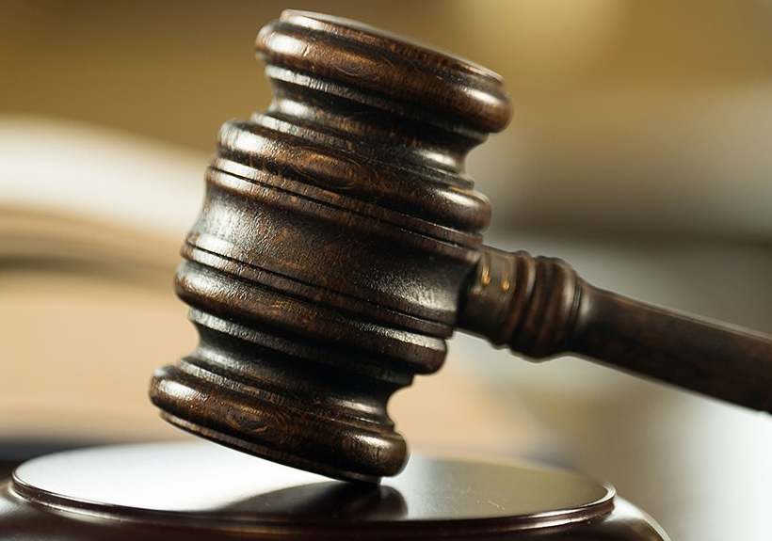
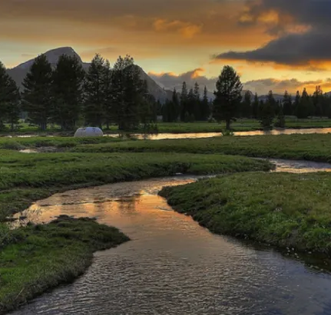
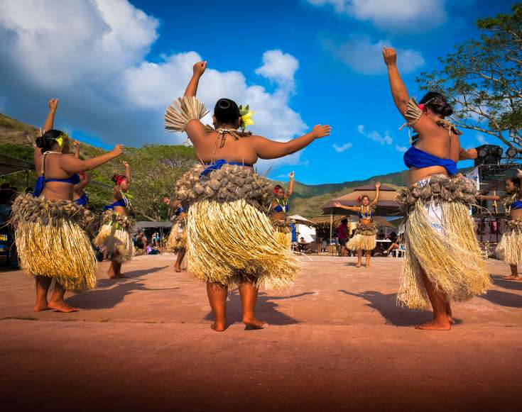
What are Values?
Law
Values are the things that the players find
desirable or important.
Many environmental issues become controversial because
different players value different things!
Aesthetics Community Culture Ecology Economics Education
Personal Rights
Recreation

Slide 14
What are Opinions?
Opinions are ideas or judgments about the issue—whether true or false—that is held by one of the players

Slide 15
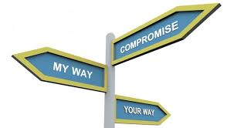
What are Solutions?
Solutions are various strategies proposed to resolve the issue.
A successful solution involves the players and considers their values, and reaches a compromise that no player is seen as the “winner” or “loser”

Slide 16
PLT Activity – Issue 1: Wind Farm Proposal Read the article and complete the Student page – Analyzing the Issue

Slide 17
Class Discussion – Wind Farm Proposal
Discussion
Research –
Are there wind farms in your state? If yes, where are they located and how many turbines are at the site(s)?
Are there any new proposals for wind farms in your state?
Would you be for or against the development of new wind farms in your state? (Be prepared to explain why)

